Slide 1
The Heritage Health Prize Challenge Using Python
Steven Strauss
Indiana University
INFO-I 526
Applied Machine Learning
Spring 2018

Slide 2
Project Background
The Heritage Health Prize Challenge was a Kaggle Competition from April 2011 – April 2013, sponsored by Heritage Provider Network (HPN)
HPN wanted to help the health care system by identifying patients who were most at risk earlier to ensure they were given the proper treatment
Goal was to create an algorithm that predicts how many days a patient will spend in a hospital
For more details, visit: https://www.kaggle.com/c/hhp

Slide 3
Data Introduction
The data provided was historical data over the span of three years (years 1, 2, 3)
Member data - MemberID and their sex/age
Claims data - Member’s visits to a hospital by year
Included info on service done, place, doctor, procedure group, condition, etc.
Lab Data - Lab tests conducted on members by year
Drug Data - Prescriptions filled by members by year
Data was provided for the number of days in hospital for the following years (years 2, 3, 4):
Year 4 (“Target”) data was blank for length of stay
Meant for Kaggle participants to predict the length of stay
Purpose of data was to evaluate prior year and predict next year’s days spent in hospital
For more details, visit: https://www.kaggle.com/c/hhp/data

Slide 4
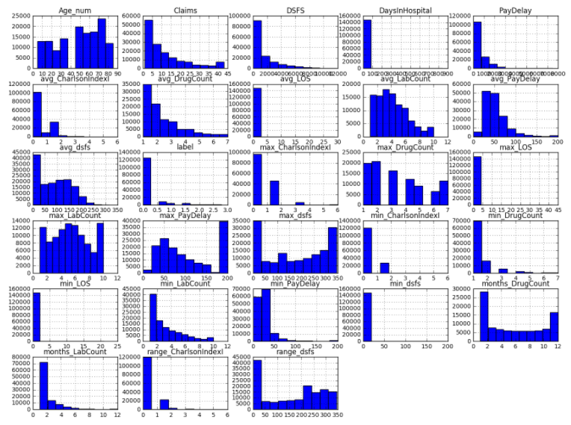
Pre-processing and EDA
Loaded data into Jupyter Notebook using Python coding
All valued data was converted into values/floats
Min, Max, Average, Range calculated
for value/float data
Now had a total of 27 numerical
attributes
Correlation Matrix to show data
Pipeline used for numerical and
categorical features
Standard Scaler (mean, std dev) and
Imputer (median)
Used OHE on categorical attributes

Slide 5
Baseline Modeling and Feature Engineering
Training data = Year 1 observations | Target data = Days in hospital in Year 2
Testing data = Year 2 observations | Target data = Days in hospital in Year 3
Model Selection:
Baseline: Untuned Logistic Regression and Untuned Ridge Regression
GridSearch: Tuned versions of…
Stochastic GD, Random Forest, KNN, Naïve Bayes, Logistic Regression, Ridge Regression, SVM
Success Metric
Prediction accuracy for days in hospital
RMSE

Slide 6
Results
Untuned Ridge Regression consistently had the best accuracy (85%) and fastest run times in terms of predicting accuracy, along with the lowest RMSE (1.49204)
When tuning features, run time took longer and prediction accuracy suffered
Logistic Regression and Random Forest were next best algorithms, with equally good prediction accuracy, but slightly higher RMSE
Stochastic GD also a good predictor, but RMSE calculation returned errors
KNN had good accuracy, but a very long run time
Naïve Bayes, even after tuning, predicted poorly
SVM could not process (took too long to run)

Slide 7
Next Steps
More EDA after data has been scaled to get a better understanding on which features predict Days in Hospital well
Continue training and testing with different input features (include more highly correlated features and remove lesser correlated features)
Certain features (ProviderID, VendorID, etc) were not used as there were thousands of different records. One hot encode could provide more correlated features
Try more hyperparameter tuning with different algorithms (SVM if allotted more time)
Fix RMSE calculation for algorithms that returned errors

